Slide 1
Who am I?
Sean Simmons
Student at WGU, enrolled in the M.S. of Data Analytics
Graduated with a B.S. of Biochemistry and Molecular Biology
Chemistry teacher
Lives in Atlanta and enjoys reading and videogames

Slide 2
Video Game Global Sales
Predictions
WGU D214 Capstone

Slide 3
Hypothetical Business
Video Game Producer
“We are looking at sales, and we want to do predict how well our game will sell?” We had a previous team create a dataset listing video game sales
How we can look at it:
“Can we create a multiple linear regression model (MLR) to predict future global sales?”

Slide 4
Hypotheses
Null hypothesis- We can not create a model to statistically significantly predict video game global sales.
Alternate Hypothesis- We can create a model to statistically significantly predict video game global sales.

Slide 5
The Data-Analysis Process
Download the dataset
View it, assess it with exploratory data analysis (EDA)
Clean it
Perform a MLR model
Assess the model and respond to our hypotheses

Slide 6
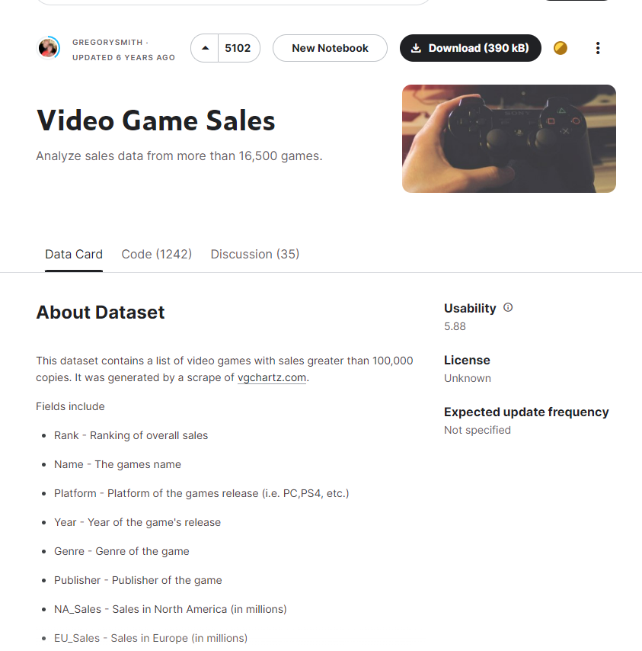
Downloading the dataset
Download the dataset from kaggle, open source
Video Game Sales. (n.d.). Www.kaggle.com. https://www.kaggle.com/datasets/gregorut/videogamesales

Slide 7
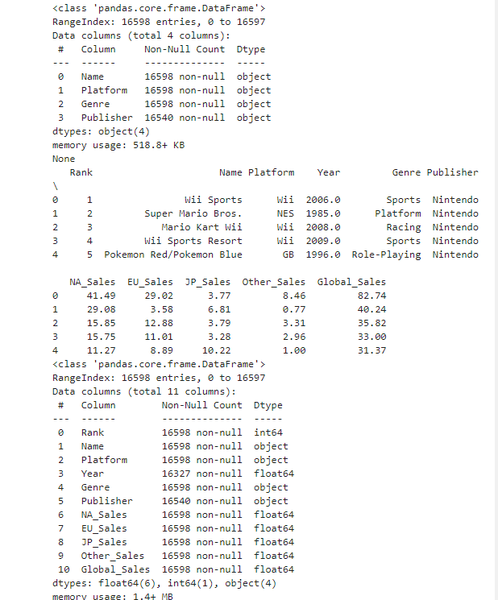
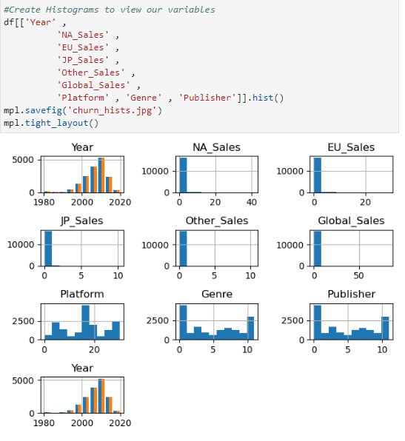
EDA

Slide 8
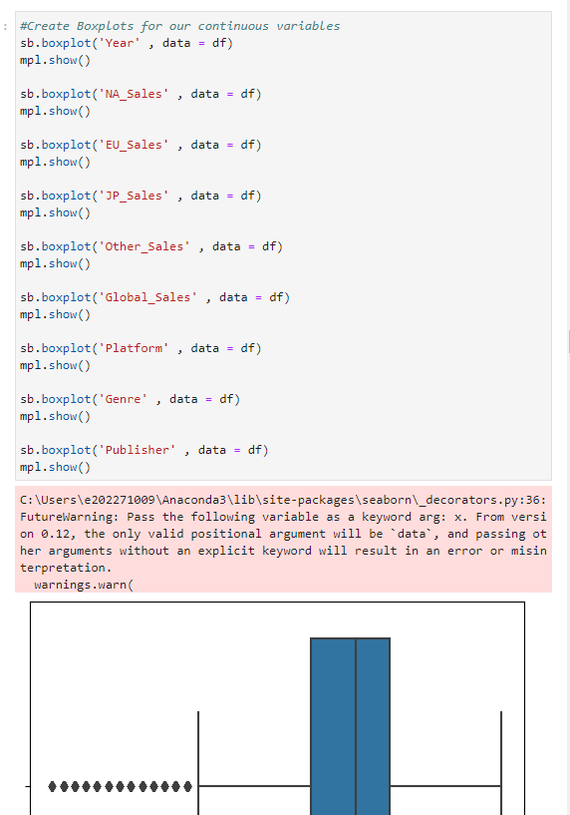
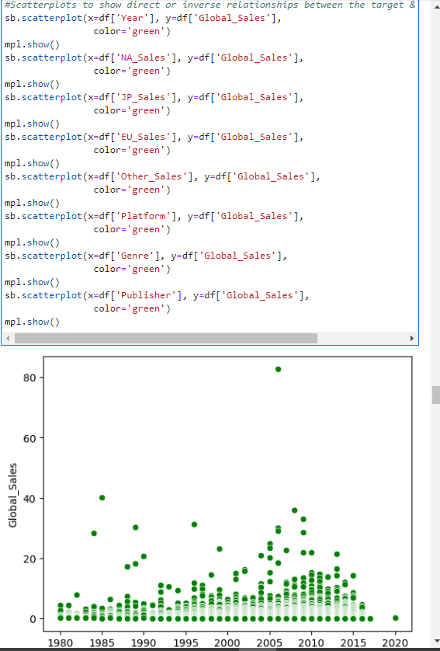

Slide 9
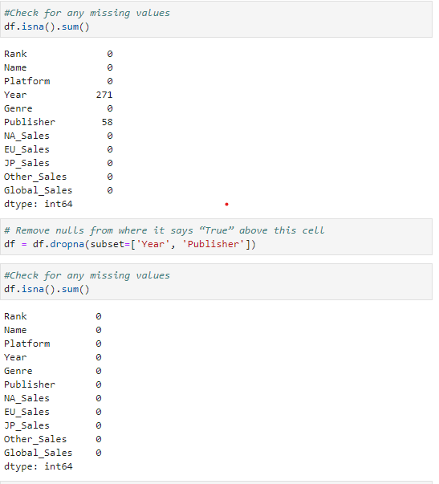
Cleaning the data (Fill missing values with zero)

Slide 10
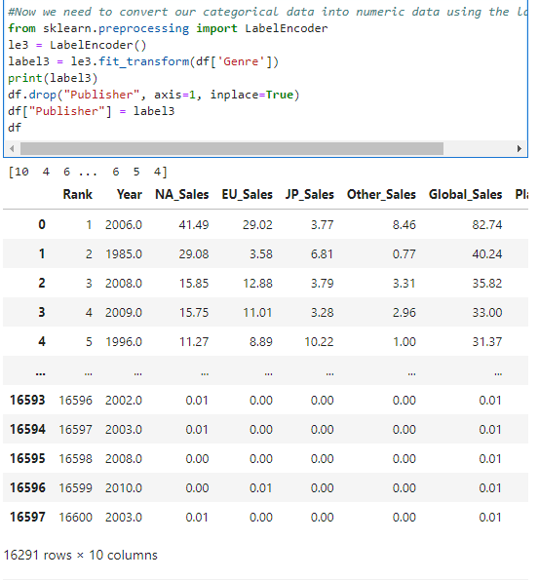
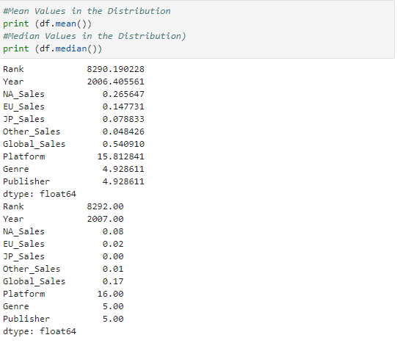
Cleaning Part 2: Converting

Slide 11
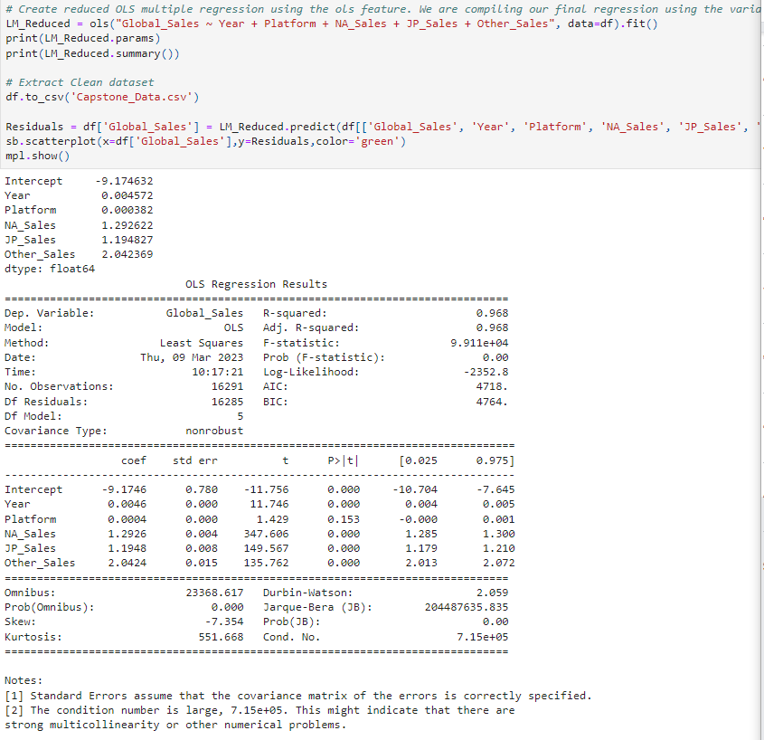
MLR model
Basically, it worked!
We have a model to predict future global sales, we fail to reject our null hypothesis!

Slide 12
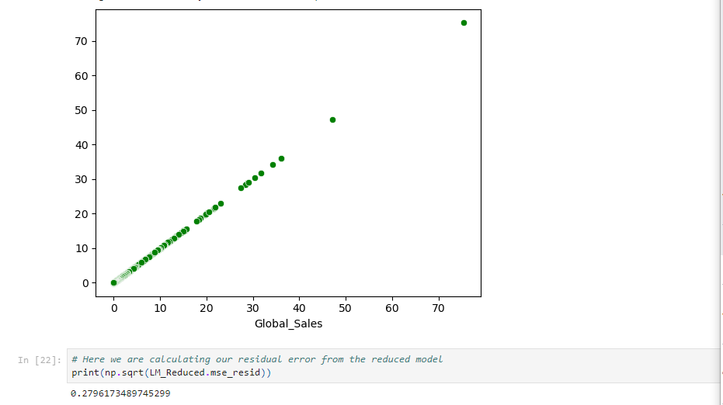
Assessment

Slide 13
Outline of the Findings
Yes we can create a predictive model!
y = -9.174632 + (Year * 0.004572) + (Platform * 0.000382) + (NA_Sales * 1.292622) + (JP_Sales * 1.194827) + (Other_Sales * 2.042369)
The coefficients suggest that per each unit of the following, Global Sales will increase or decrease by the following per one unit of the variable:
Year, Global Sales will increase by 0.0046
Platform, Global Sales will increase by .0004
NA_Sales, Global Sales will increase by 1.12926
JP_Sales, Global Sales will increase by 1.1948
Other_Sales, Global Sales will increase by 2.0424

Slide 14
Know the stats
The model has a 96.8% strength of prediction
Has a residual error value of .28, a low number, which is GOOD!
High condition number, multicollinearity may be a factor and more investigation is needed, aka there are some issues we need to keep looking into.

Slide 15
Explanation of the limitations of techniques/tools
Limitations:
MLR can only show linear relationships
MLR can’t show causality
Have to use multiple packages as sklearn cannot visualize data
Tools:
The model was created in jupyter labs v3.44 and python v3, Sklearn was used to run it
So, what does it all mean?

Slide 16
Summary of Proposed Actions
Build on the investigation
Open up the analysis to non-linear relationships
Greatly increase the size of the dataset and the characteristics listed within the dataset
Advance into the second stage
Build a model to predict future global sales with further information gathering, aka
where the game was released
which time of year
if other major titles released during the same time
overall inflation/economy at the time since the sales span many years.

Slide 17
Expected Benefits of the study
Alternate Hypothesis- We can create a model to statistically significantly predict video game global sales.
Use this model to…
Predict future global sales given characteristics of the game using the equation.
Identify key characteristics in high performing games if needed
Have a launching point for further investigation

Slide 18
With the Numbers
We can now use the following to predict future global sales for video games with a 96.8% strength of prediction.
y = -9.174632 + (Year * 0.004572) + (Platform * 0.000382) + (NA_Sales * 1.292622) + (JP_Sales * 1.194827) + (Other_Sales * 2.042369)

Slide 19
Thank you! - Main takeaways
Hypothetical Question- Can we predict future global video games sales using multiple linear regression?
We downloaded,cleaned, and assessed the data in jupyter labs using python
Performed several MLR models, found a statistically significant grouping of variables after reduction
We have a model that can be used to predict future global sales!
Proposed Actions include advancing the investigation with a non-linear model, gathering more data and investigating it with the same model and putting more resources into the final list of variables and regression equation.

Slide 20
Panopto Link to the Presentation
https://wgu.hosted.panopto.com/Panopto/Pages/Viewer.aspx?id=a9220d12-0ef5-4c36-928c-afc00177aa3d

